Slide 1
Preschool Professional
Module 1
Instructor-Sidra Rauf
Area- STEM/STEAM Education
LESSON 2: AN INTRODUCTION TO STEAM INQUIRIES & LESSON PLANNING part 1

Slide 2
Course Content
Using inquiry and project-based learning to deliver STEAM
Create a STEAM PBL lesson using inquiry-based learning.
Implementing a PBL Lesson: Tips

Slide 3
Course Objective
This course will enable you to:
able to deliver STEAM using inquiry and project-based learning
able to design a STEAM PBL session
able to deliver STEAM using inquiry and project-based learning

Slide 4
Using inquiry and project-based learning to deliver STEAM
Different forms of learning, or a combination of modes of learning, can be used to facilitate STEAM education.
In this session, we'll look at two interconnected teaching approaches that are frequently utilized in STEAM sessions, sometimes in tandem: inquiry-based learning and project-based learning.

Slide 5
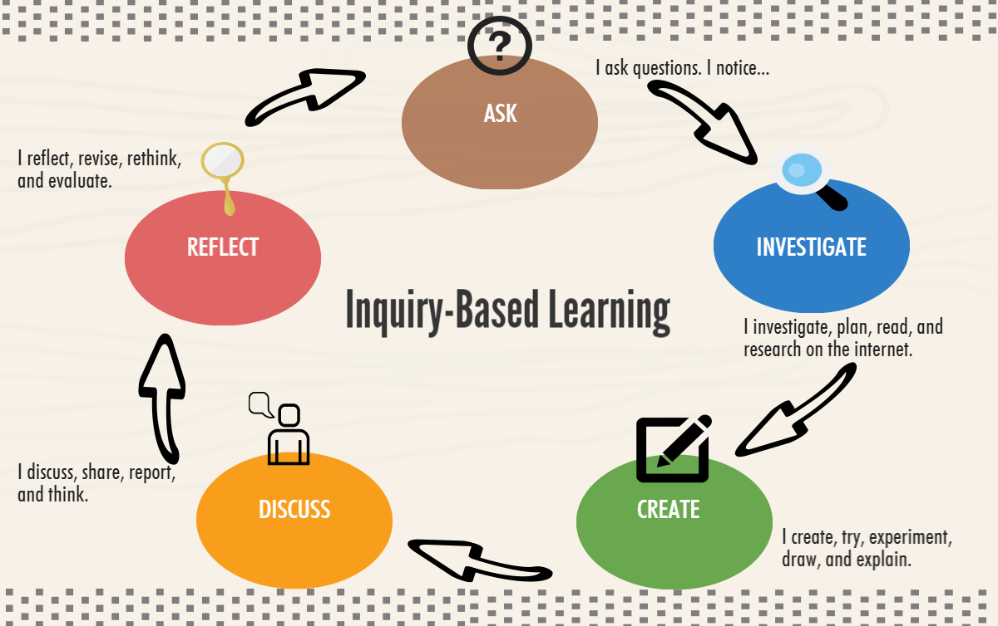
Inquiry-based Learning

Slide 6
Teachers who want to engage with their students and use STEAM ideas should use inquiry-based teaching methodologies. Let's get started by learning about the four inquiry-based teaching strategies.

Slide 8
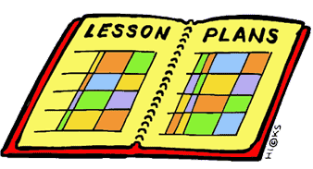
Create a STEAM PBL lesson
It is advised that teachers use a backward design approach and start with the end in mind when creating STEAM PBL projects.
Teachers must also ensure that the PBL is aligned with the curriculum and covers significant standards, as well as that students have many opportunities to discuss important subject throughout the project.

Slide 9
The following elements are commonly seen in project-based learning:
Scenarios from real life
Multiple-skills assessment units
Units that involve multi-subject research and comprehension
Optional for students
Collaboration
Various modes of communication (writing, oral speaking, visual presentations, publishing, etc.)Expertise from the real world is brought into the classroom.

Slide 10
The following elements are commonly seen in project-based learning:
Role-playing
Genres of writing that are mixed
Various reading genres
Authentic evaluations
Audiences with integrity

Slide 11
Investing time in designing PBL has a big impact on how interesting and effective it is for kids. Teachers must have the following skills:
A realistic understanding of what is required for the final product to be successful and impactful.
They are able to communicate these expectations to children in a clear and concise manner.
They will be able to discuss the importance of the process with kids.
Students must have a clear awareness of project constraints and resources available so that they do not plan beyond their capabilities!

Slide 12
Here are some planning questions to think about:
Identifying a compelling motivating question
What are the project's learning objectives?
What are the two or more STEAM disciplines that will be evaluated?
What are the other topics and standards that will be covered in the curriculum?
How does the project connect students to a real-world experience, and how will they engage in true problem solving in the real world?
What kind of outputs or products will the pupils produce? What is the activity's structure and sequence?

Slide 13
Here are some planning questions to think about:
How will students use their voices and choices to help design the learning?
What is the timescale for completing activities such as product research and development?
What are the supplies that will be needed to complete the activities?
What criteria will be used to evaluate assessments? And, before, during, and after the PBL, what are the assessment points and activities?

Slide 14
some pointers on how to implement a PBL lesson:
START WITH THE MOTIVATING QUESTION
TIME ALLOCATION
DESIGN OPPORTUNITIES FOR ASSESSMENT GETTING READY AHEAD OF TIME
REFLECTION:

Slide 16
Thank You

